Slide 1
Chap 7: Knowledge representation
Group 7:
Pham quang loc
Doan tan trung
Nguyen vu duy

Slide 2
Outline:
7.1: A Brief History of AI Representational Schemes
7.2: Conceptual Graphs: a Network Language
7.3: Alternative Representations and Ontologies
7.4: Agent-Based and Distributed Problem Solving
Summary

Slide 3
7.1 A Brief History of AI Representational Systems
There are many problems that arise in mapping commonsense
reasoning into formal logic. For example of the operators ∨ and → as corresponding to the English “or” and “if ... then ...”.
  For example, the sentence “If a bird is a cardinal then it is red”
∀ X (cardinal(X) → red(X)).
  With truth-preserving operations, Chapter 2
∀ X (¬ red(X) → ¬ cardinal(X))

Slide 4
Example: ∀ X (cardinal(X) → red(X)) & ∀ X (¬ red(X) → ¬ cardinal(X))
Same truth value. However, truth value equivalence is inappropriate
The reason:
  Logical implication only expresses a relationship between the truth values of its operands.
  While the English sentence implied a positive relation between membership in a class and the possession of properties of that class.
  In fact, the genetic makeup of a bird causes it to have a certain color. This relationship is lost in the second version of the expression.

Slide 5
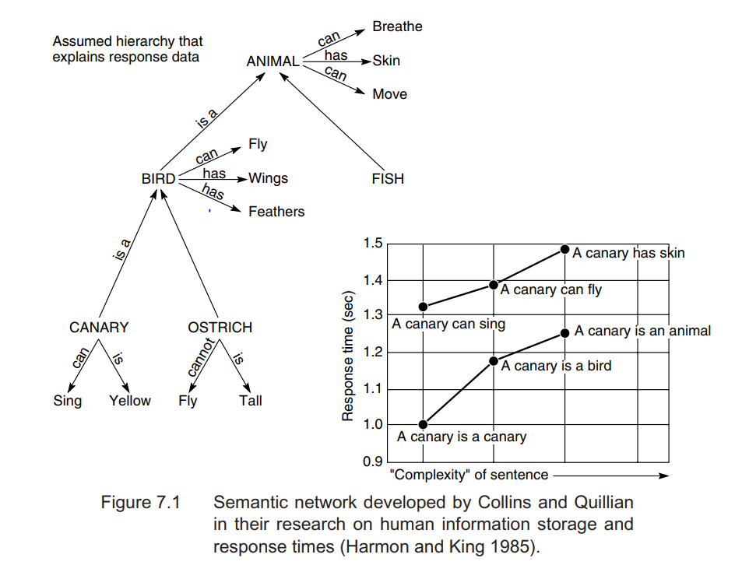
In addition to their ability to associate concepts, humans also organize their knowledge hierarchically, with information kept at the highest appropriate levels of the taxonomy.
→ People store information at its most abstract level

Slide 6
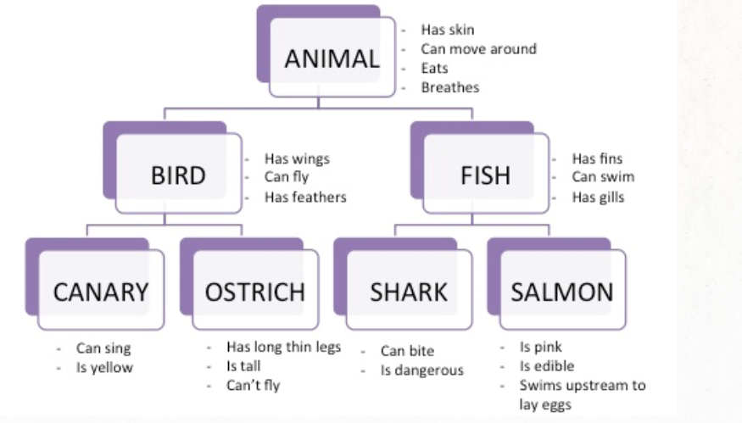
Inheritance systems
  Store information at the highest level of abstraction, which reduces the size of knowledge bases and helps prevent update inconsistencies.
  Maintain the consistency of the knowledge base when adding new classes and individuals.

Slide 7
7.1.2 Early Work in Semantic Nets
Semantic Memory: It is based on explicit facts but we also use implicit knowledge that is called common sense that comes from our experiences.
  For example: the concept “snow” with other concepts such as cold, white, snowman, slippery, and ice.
A semantic network:
  Represents knowledge as a graph, with the nodes corresponding to facts or concepts and the arcs to relations or associations between concepts. Both nodes and links are generally labeled.
  Collin and Quillian believed that semantic memory is organized into a set of connected ideas.
  Information is organized into nodes or categories that are connected to words or concepts that relate to it.
Notes:
_For example: through experience, we
associate the concept snow with other concepts such as cold, white, snowman, slippery, and ice. -> "snow is white" & "the snowman is white"

Slide 8
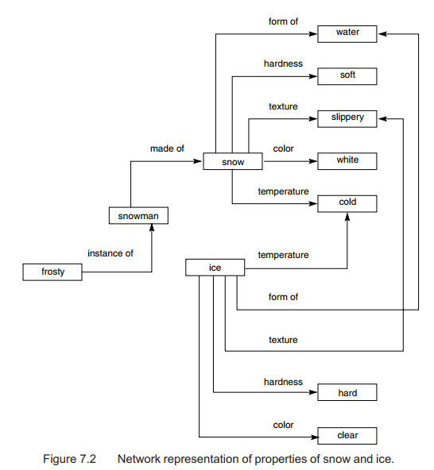

Slide 9
7.1.2 Early Work in Semantic Nets
Language understanding requires an understanding of common sense, the ways in which physical objects behave, the interactions that occur between humans, and the ways in which human institutions are organized.
A natural language program must understand intentions, beliefs, hypothetical reasoning, plans and goals.
→A driving force for research in knowledge representation.

Slide 10
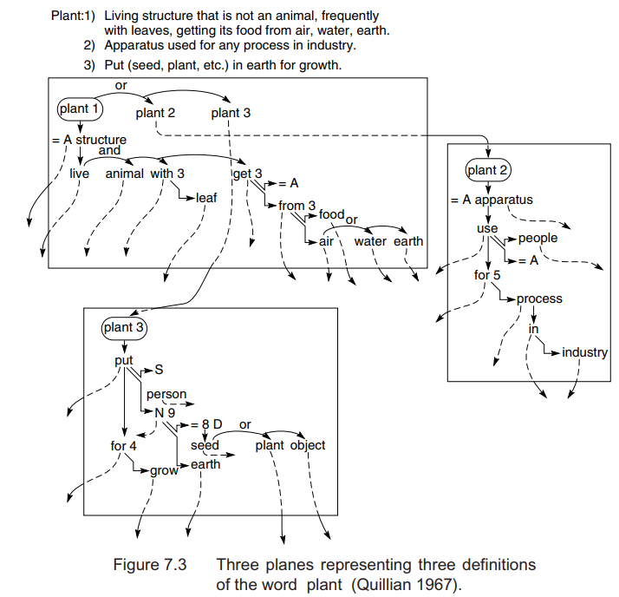
- Each node in Quillian’s network corresponded to a word concept, with associative links to other word concepts that formed its definition.
- The knowledge base was organized into planes, where each plane was a graph that defined a single word.
- Illustrates three planes that capture three different definitions of the word “plant:” a living organism (plant 1), a place where people work
(plant 2), and the act of putting a seed in the ground (plant 3).
→ The program used this knowledge base to find relationships between pairs of English words.

Slide 11
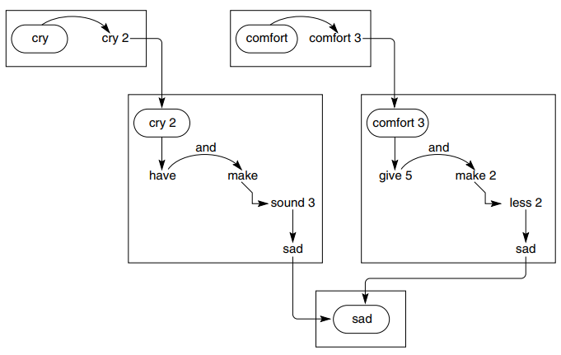
7.1.3 Standardization of Network Relationships
The program used this knowledge base to find relationships between pairs of English words. Given two words, it would search for a common concept or intersection node. The paths to this node represented a relationship between the word concepts.
  For example: the intersection paths between cry and comfort. The spreading activations would intersect at the words "sad", and the English account would express "to cry is to make a sad sound, and to comfort is to make something less sad"
→ When a node in a semantic network is excited is spreads to other connections in the network.
Notes:
Given two words, it would search the graphs outward from each word in a breadth-first fashion, searching for a common concept or intersection node. The paths to this node represented a relationship between the word concepts.

Slide 12
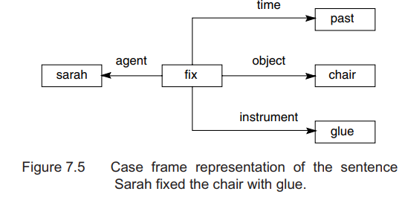
7.1.3 Standardization of Network Relationships
Simmons (1973) focused on the case structure of English verbs. Case relationships include agent, object, instrument, location, and time. This structure is called a case frame.
  For example: the sentence “Sarah fixed the chair with glue” be represented by the network.

Slide 13
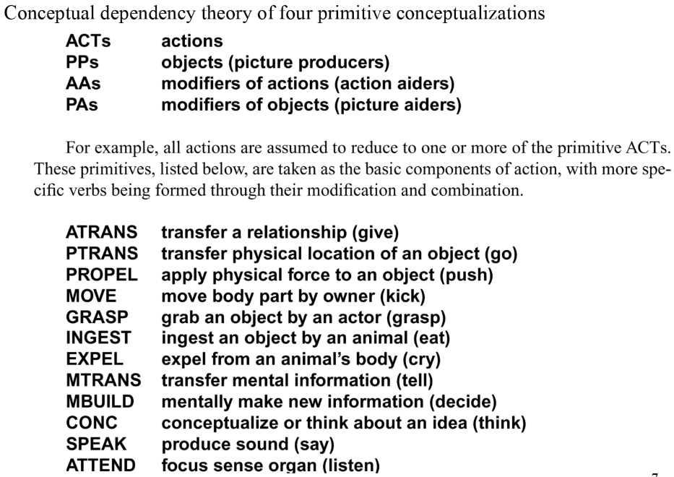

Slide 14
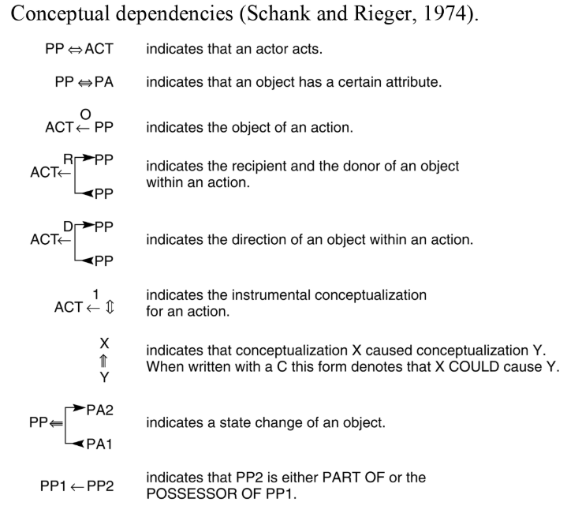
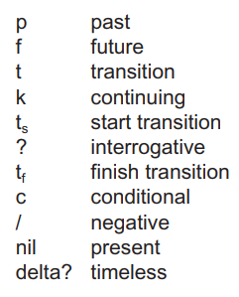
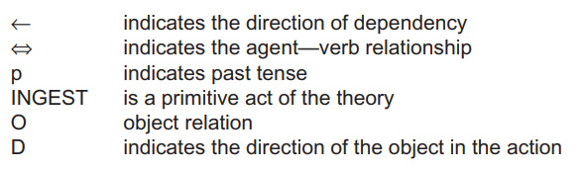

Slide 15
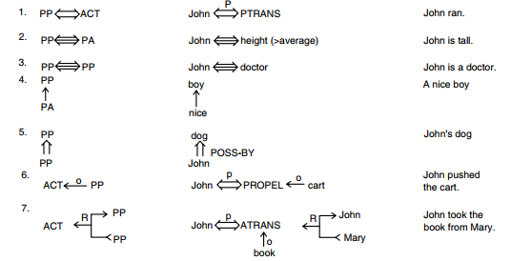

Slide 16
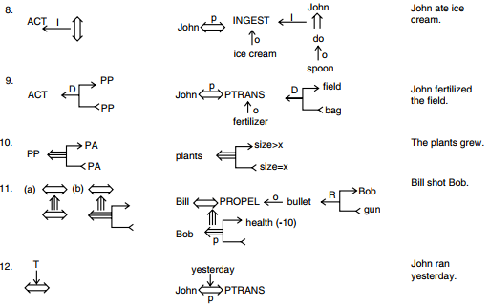

Slide 17
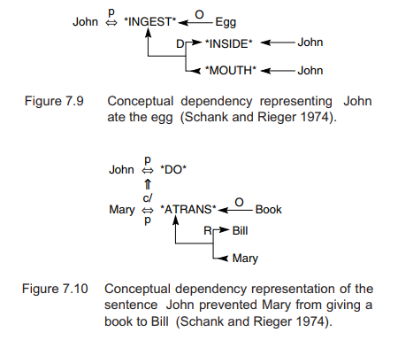
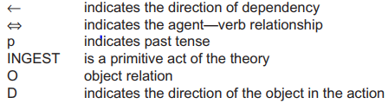

Slide 18
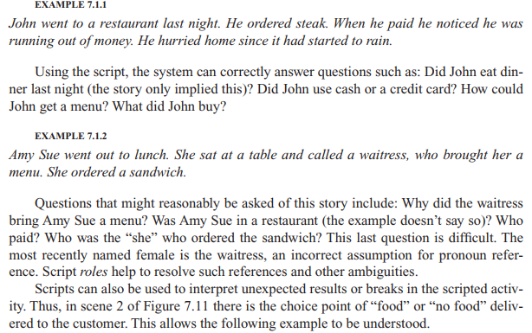
7.1.4 Scripts

Slide 19
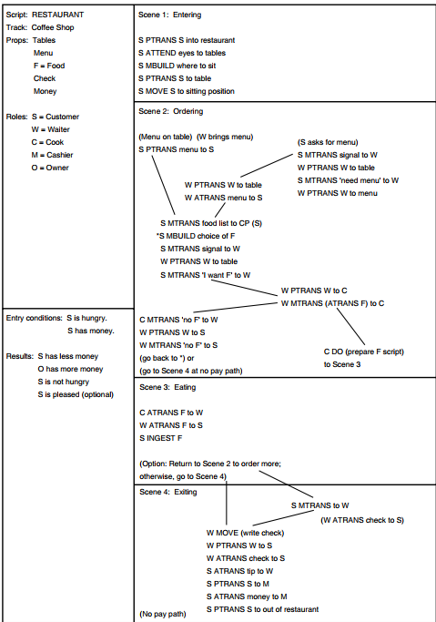
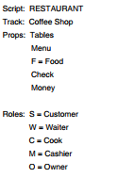
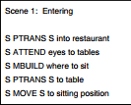

Slide 20
7.1.5 Frames
Were proposed by Marvin Minsky in 1974.
Are the primary data structure used in AI frame language.
What are they?
  Frames are record like structure that have slots and slot values for an entity.
    A slot in frame specify a characteristic of an entity.
    A slot in frame contains information as attribute-value pairs, etc.

Slide 21

7.1.5 Frames (cont.)
Example 1: Superhero details
Tony Stark (
(Job (Value Billionaire industrialist))
(Date of Birth (Value May 29, 1970)
(Date of Death (Value 2023)
(Age (Value 53))
)

Slide 22
7. 2.1 Conceptual Graphs:
A network language
  Are based upon the following general form:
  May be read as: “The relation of a Concept_1 is a Concept_2 ”
Concept_1
Relation
Concept_2

Slide 23
7. 2.1 Conceptual Graphs:
A network language (cont.)
  Concept box is labeled with a type label, which indicates the class or type of individual.
  Example:
  May be read as: “The employee as known as Simon”.
  Type: Employee, individual label: Simon.
  Type and individual label are separated by a “ : “
Employee: Simon

Slide 24
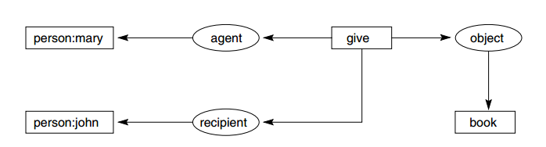
7. 2.1 Conceptual Graphs:
A network language (cont.)
  Conceptual graph of “Mary gave John the book”

Slide 25

7. 2.1 Conceptual Graphs:
A network language (cont.)
  # (marker) indicate specific but unnamed individuals.
  A particular dog, #1352, is brown.

Slide 26
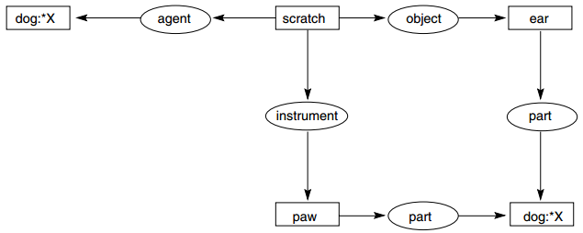
7. 2.1 Conceptual Graphs:
A network language (cont.)
  Besides makers or names, we use * (generic maker) to indicate an unspecified individual.
  CG of a sentence “The dog scratches it ear and its paw
Notes:
A concept given just a type label: dog == dog:*
Although we do not know which dog is scratching its ear, the variable *X indicates that the paw and the ear belong to the same dog that is doing the scratching.

Slide 27
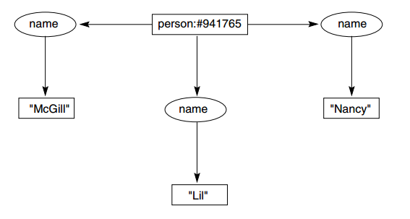
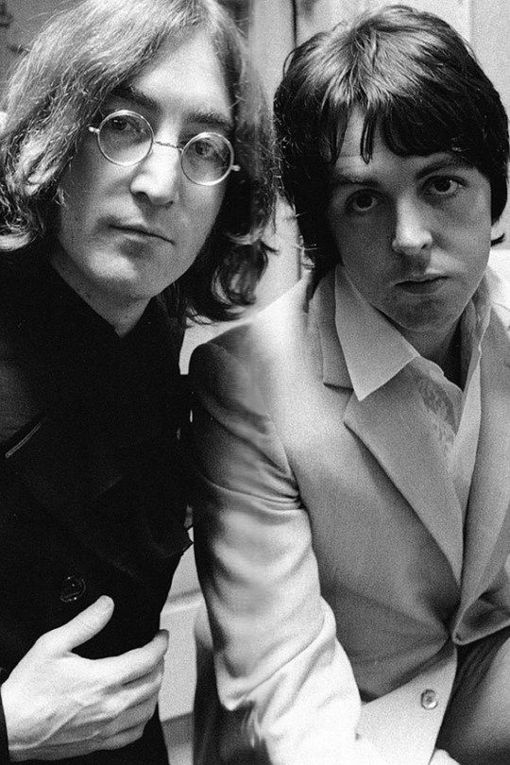
7. 2.1 Conceptual Graphs:
A network language (cont.)
  An individual can have several different names.
  “Her name was McGill, and she called herself Lil, but everyone knew her as Nancy” (Lennon and McCartney 1968). – Song lyrics

Slide 28
7. 2.2 the type hierarchy
  The type hierarchy indicated by the symbol “≤”
  If s and t are types and t ≤ s, then t is said to be a subtype of sand s is said to be a supertype of t.
  If s, t, and u are types, with t ≤ s and t ≤ u, then t is said to be a common subtype of s and u
  Similarly, if s ≤ v and u ≤ v then v is a common supertype of s and u.
  The universal type, indicated by ┬, is a supertype of all types.
  The absurd type, indicated by ⊥, is a subtype of all types.

Slide 29
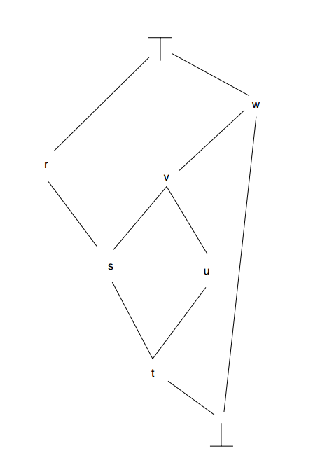
7. 2.2 the type hierarchy (Cont.)
  Example of subtypes, supertypes, universal type and absurd type.

Slide 30
7. 2.3 generalization and specialization
  In CG, new graphs can be formed from existing graphs using number of operations.
  4 basic operations are: copy, restrict, join and simplify

Slide 31
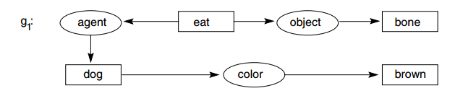

7. 2.3 generalization and specialization (cont.)
  Copy rule: form new graph g, exactly copy of g1.

Slide 32
7. 2.3 generalization and specialization (cont.)
  Restrict rule: replace a concept node in a graph by a node representing their specialization.

Slide 33
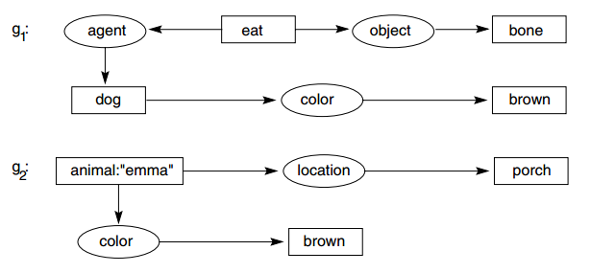
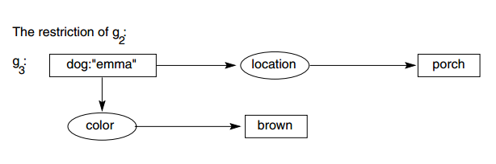
7. 2.3 generalization and specialization (cont.)

Slide 34
7. 2.3 generalization and specialization (cont.)
  Join rule: combine to graphs into a single graph.

Slide 35
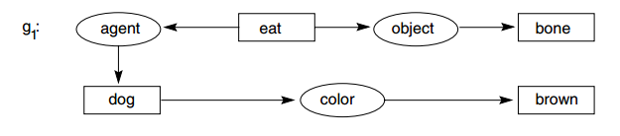
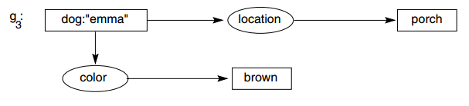
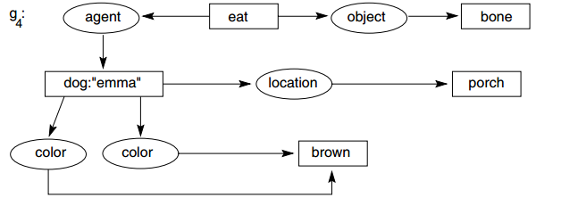
7. 2.3 generalization and specialization (cont.)

Slide 36
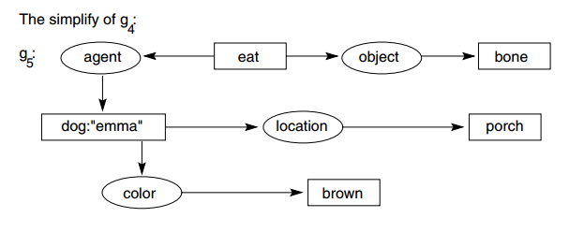
7. 2.3 generalization and specialization (cont.)
  Simplify rule: combine to graphs into a single graph.

Slide 37
7. 2.4 propositional nodes
  Conceptual graphs include a concept type, proposition, that takes a set of conceptual graphs as its referent and allows us to define relations involving propositions.
  Propositional concepts are indicated as a box that contains another conceptual graph.

Slide 38
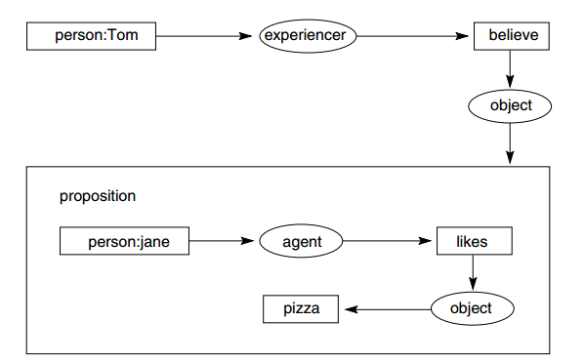
7. 2.4 propositional nodes (cont.)
  CG of “Tom believes that Janes likes pizza” using propositional nodes.
Notes:
t

Slide 39
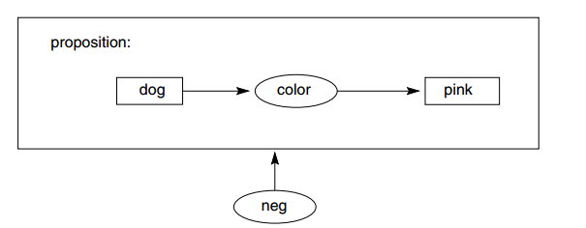
7. 2.5 conceptual graphs and logic
  “The dog is big and hungry” can be easily represent by CG.
  How about “There are no pink dogs” sentence?
  Using neg operation, we can implement negation and propositional concepts

Slide 40
7. 3 Alternative Representations and Ontologies
Brooks’ Subsumption Architecture
Copycat
Multiple Representations, Ontologies, and Knowledge Services

Slide 41
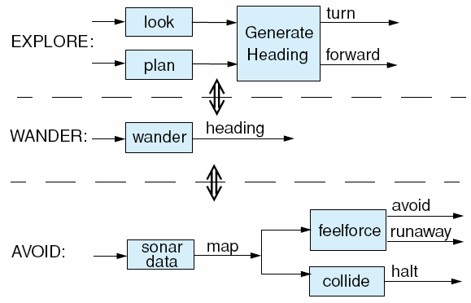
Brooks’ Subsumption Architecture
Rodney Brooks from MIT.
Subsumption architecture : a layered collection of task-handlers
Rule: condition → action
Example: A robot
  12 sonar sensors
  AVOID: keep robot from hitting objects
  WANDER: generate random directions
  EXPLORE: look for object and plan a path

Slide 42
Brooks’ Subsumption Architecture
Concern:
  Problem of sufficiency of information at each system level
  How can the limited input on the local situation
  How can a purely reactive component with very limited state learn from its environment
  Problem of scale

Slide 43
Copycat
Build on many of the representational techniques that preceded it
Contrast with Brooks’s approach, Copycat requires a global “state” to be part of the problem solver
Three components:
  workspace
  slipnet
  coderack

Slide 44
Copycat
Three components:
  workspace: global structure, other components of the system can inspect.
  slipnet: network of concepts or potential associations
  coderack: priority based probabilistic queue containing codelets (small pieces of code)
Nodes in the slipnet generate codelets and post them to the coderack, system maintains code in parallel that compete for the chance to find and build structures in the workspace.

Slide 45
Copycat
Cohesion: connection among the structures built in the workspace
Low cohesion: biases of the probabilistic choices are less important.
High cohesion: biases become important.

Slide 46
Multiple Representations, Ontologies, and Knowledge Services
Complex AI applications require multiple representational schemes, each for a specific task.
Ontology: being or existence. It refers to components of a software module and structure supporting the interactions of these components.
Application for ontology based knowledge services: agent-oriented problem solving

Slide 47
7.4. Agent-Based and Distributed Problem Solving
Agent-Oriented Problem Solving: A Definition
Examples of and Challenges to an Agent-Oriented Paradigm

Slide 48
Agent-Oriented Problem Solving: A Definition
Multi-agent system: computer program with problem solvers situated in interactive environments
four criteria:
  situated
  autonomous
  flexible
  social

Slide 49
Agent-Oriented Problem Solving: A Definition
Situated: receives input from the environment and effect changes in that environment
Autonomous: interact with its environment without the direct intervention of other agents
Flexible: both intelligently responsive and proactive depending on its current situation
Social: interact, as appropriate, with other software or human agents

Slide 50
Agent-Oriented Problem Solving: A Definition
Multi-agent systems are ideal for representing problems that include many problem-solving methods, multiple viewpoints, and multiple entities
Suitable for distributed and concurrent problem solving
Four characteristics:
  each agent has incomplete information, suffer limited viewpoint
  no global system controller for the entire problem solving
  knowledge and input data for the problem is also decentralized
  reasoning processes are often asynchronous

Slide 51
Examples of and Challenges to an Agent-Oriented Paradigm
Manufacturing: production sequencing,…
Automated control: spacecraft control, air traffic control,…
Telecommunications: network control and management, …
Transportation Systems: cooperative transportation scheduling,…
Information Management: web browsing assistant, …
E-Commerce: buy and sell decisions in the stock market, …
Interactive Games and Theater: challenge in war games, sports, …

Slide 52
Summary
Major alternatives for knowledge representation, including the use of logic, rules, semantic networks, and frames
Systems with no centralized knowledge base or general-purpose reasoning scheme
Distributed problem-solving with agents

Slide 53
reference
Artificial Intelligence. Structures and Strategies for Complex Problem Solving. Sixth Edition-Addison Wesley (Luger 2009)
Cognitive Science: The Science of Intelligent Systems (Luger 1994)
An Overview of Knowledge Representation (Mylopoulos and Levesque 1984)
Representations of Commonsense Knowledge by Davis (1990)

Slide 54
Thank you for your listening

